Slide 1

Digital Signal Processing
You need to Study
 | TOPIC
1 | Discrete Time signals
2 | Discrete Fourier Transform
3 | Z-Transform
4 | Discrete Time System
5 | Digital Filter Design
Kiran TALELE 99870 30 881 kiran.talele@spit.ac.in

Slide 2








Digital Filter Design
DSP
Discrete Time System
Z-Transform
Discrete Fourier Transform
Discrete Time Signal
Kiran TALELE 99870 30 881 kiran.talele@spit.ac.in

Slide 3
Kiran TALELE
@ Bharatiya Vidya Bhavans’ Sardar Patel Institute of Technology Andheri(w) Mumbai
Associate Professor, Electronics Engineering Department (1997)
Dean, Students, Alumni & External Relations (2022)
@ Sardar Patel Technology Business Incubator(SP-TBI),
Funded by Department of Science & Technology(DST),
Govt. of India
Head, Academic Relations (2015)
@ IEEE Bombay Section
Treasurer (2020)
Executive Committee Member (2015)
Kiran TALELE

Slide 4

DT SIGNAL
Kiran TALELE
 99870 30 881

Slide 5
Chapter-1 : Discrete Time Signal
Objective : To learn the fundamental concepts of Digital Signal Processing
Outcome : At the end of module students will be able to,
Understand the concept of DT Signal
Evaluate Sampling and Reconstruction
Perform signal manipulation
Represent DT Signal using standard signals
Classify DT signals
Perform Convolution and Correlation operation
Kiran TALELE 99870 30 881 kiran.talele@spit.ac.in

Slide 6
Contents
Introduction to Digital Signal Processing
Discrete Time Signals
Standard DT Signals
Linear Shifting of Non-Periodic Signals
Circular Shifting of Periodic Signals
Representation of DT signal using Standard DT Signals
Concept of Digital Frequency
Classification of Signals
Signal Manipulations(Shifting, Addition, Subtraction, Multiplication)
Sampling and Reconstruction
Linear Convolution
Circular Convolution
Matrix Representation of Circular Convolution
Linear by Circular Convolution
Auto and Cross Correlation formula evaluation
Kiran TALELE 99870 30 881 kiran.talele@spit.ac.in

Slide 7
# Standard Discrete Time Signals
Delta Signal OR Impulse Signal
OR Unit Sample Signal
(2) Unit Step Signal
(3) Sinusoidal Signal
Kiran TALELE 99870 30 881 kiran.talele@spit.ac.in

Slide 8
# Classification of DT Signals
Deterministic / Non-deterministic
Causal / Anti-Causal / Bothsided
Periodic / Non-Periodic
Energy / Power / Neither Energy Nor Power
Even / Odd / Neither Even Nor Odd
Kiran TALELE 99870 30 881 kiran.talele@spit.ac.in

Slide 9
(I) Deterministic / Non Deterministic Signal
If Discrete Time Signal x[n] can be represented mathematically,
Then x[n] is called Deterministic Signal
Otherwise x[n] is called Non Deterministic Signal.
e.g. x[n] = Sinusoidal Signal : cos (0.6 π n)
Noise Signal ➔ Non Deterministic
ECG Signal ➔ Non Deterministic
Kiran TALELE 99870 30 881 kiran.talele@spit.ac.in
Kiran TALELE kiran.talele@spit.ac.in

Slide 10

(II) Causal / Anti-Causal / Bothsided
Causal Signal :
If x[n] = 0 for all n < 0
Then x[n] is causal Signal.
Examples :
(i)
x[n] = u[n]
Kiran TALELE 99870 30 881 kiran.talele@spit.ac.in
Kiran TALELE kiran.talele@spit.ac.in

Slide 11

Anti-causal Signal :
If x[n] = 0 for all n ≥ 0
Then x[n] is Anti-causal signal.
Examples :
x[n] = u[-n-1]
Kiran TALELE kiran.talele@spit.ac.in

Slide 12


Both Sided Signal :
If x[n] is Neither Causal
Nor Anti-causal
Then x[n] is Both-sided signal.
Examples :
Kiran TALELE 99870 30 881 kiran.talele@spit.ac.in
Kiran TALELE kiran.talele@spit.ac.in

Slide 13
Example of Causal / Anti-causal & Both Sided ( infinite length ) Signals :
Causal signal : x[n] = u[n]
Anti-causal signal : x[n] = u[-n-1]
(iii) Both sided signal : x[n] = u[n] + u[-n-1]
Kiran TALELE kiran.talele@spit.ac.in
Kiran TALELE

Slide 14
(III) Periodic / Non-periodic Signal
If Digital frequency of signal x[n] is a rational number then x[n] is periodic.
Otherwise x[n] is Non-periodic.
Examples:
(1) x[n] = cos ( 0.3 π n )
(2) x[n] = cos( 0.3 π n + 0.5 π )
(3) x[n] = cos( 0.3 n )
Kiran TALELE 99870 30 881 kiran.talele@spit.ac.in

Slide 15
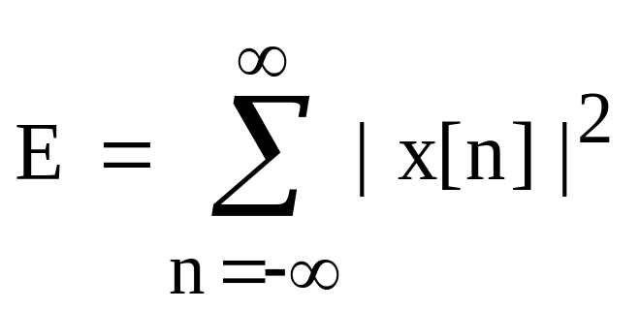
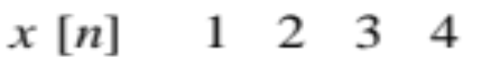

(IV) Energy / Power / Neither Energy Nor Power
1. Energy of signal is defined as,
If Energy of x[n] is finite
Then x[n] is an Energy Signal.
Examples :
Energy : 30 ( Finite )
Energy : 2 ( Finite )
Kiran TALELE 99870 30 881 kiran.talele@spit.ac.in

Slide 16
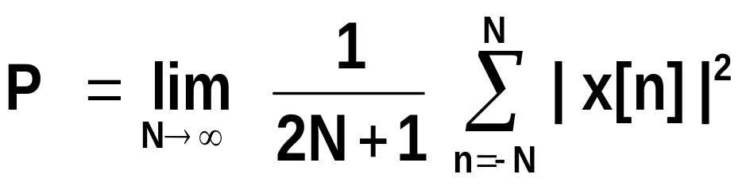
2. Average Power of signal is defined as,
If Power of x[n] is finite and nonzero
Then x[n] is a Power Signal.
Example :
x[n] = u[n]
Energy :
Power : 0.5 ( Finite )
Kiran TALELE 99870 30 881 kiran.talele@spit.ac.in

Slide 17
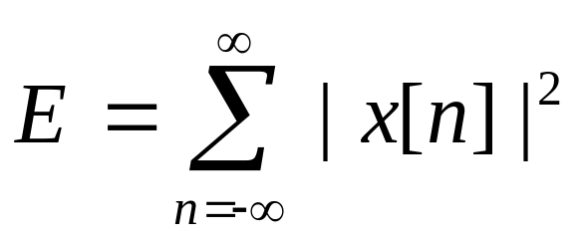
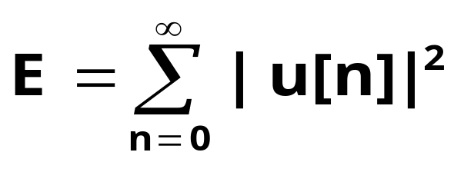
Ex-1. x[n]=u[n] ⬅ Unit Step Signal,
(i) To find Energy :
E = 1²+1²+1² +1² ….
E =
Since Energy is infinite,
u[n] is NOT an Energy Signal.
Kiran TALELE 99870 30 881 kiran.talele@spit.ac.in

Slide 18
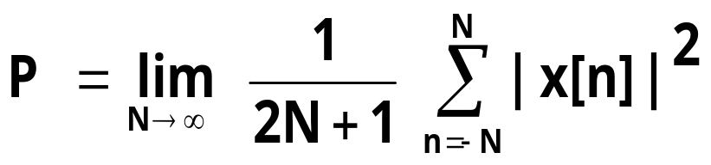
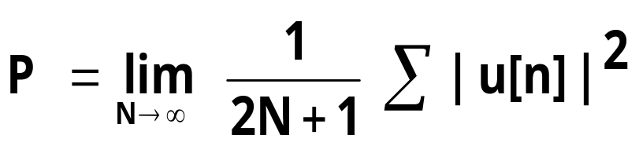


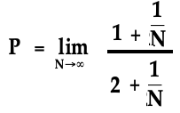

(ii) To find Average Power :
Since Average Power is finite and non zero, u[n] is a Power Signal.
Kiran TALELE 99870 30 881 kiran.talele@spit.ac.in

Slide 19
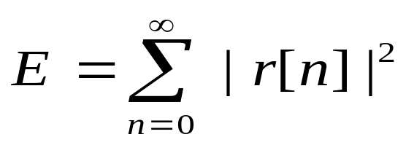

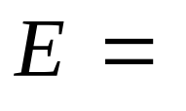
Ex-2 x[n] = r[n] ⬅ Unit Ramp Signal,,
(i) To find Energy :
Since Energy is infinite,
x[n]=r[n] is NOT an Energy Signal.
Kiran TALELE 99870 30 881 kiran.talele@spit.ac.in

Slide 20




(ii) To find Average Power :
Since Average Power is infinite ,
x[n] is NOT a Power Signal.
Kiran TALELE 99870 30 881 kiran.talele@spit.ac.in

Slide 21
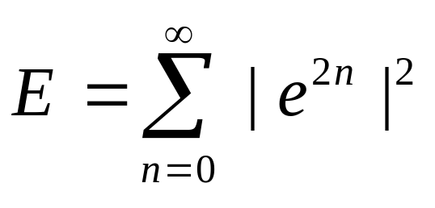
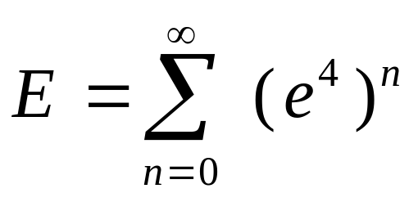
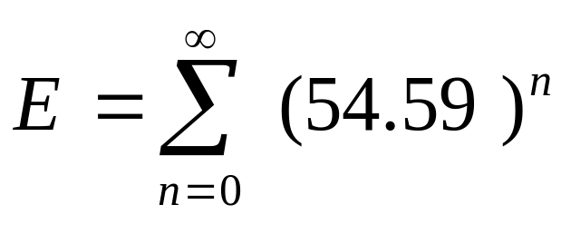

Ex-3 x[n]= e^{2n} u[n],
(i) To find Energy :
Since Energy is infinite, x[n] is NOT an Energy Signal.
Kiran TALELE 99870 30 881 kiran.talele@spit.ac.in

Slide 22
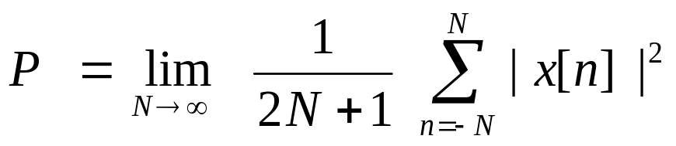
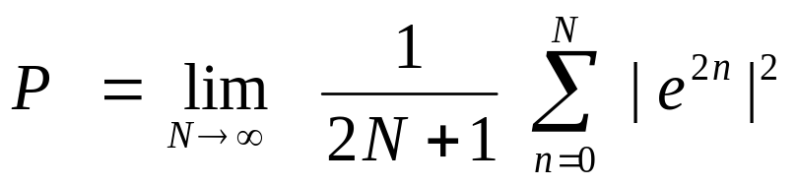
(ii) To find Average Power :
Since Average Power is infinite ,
x[n] is NOT a Power Signal.
Kiran TALELE 99870 30 881 kiran.talele@spit.ac.in

Slide 23
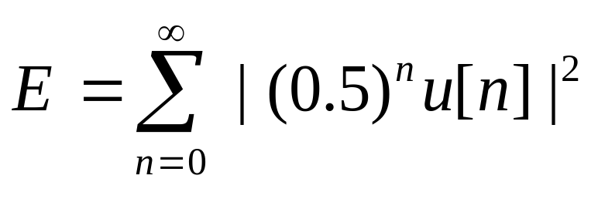
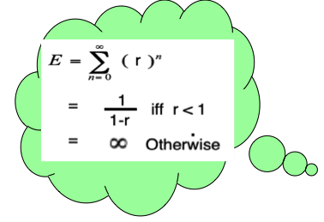
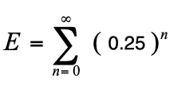


Ex-4 x[n]= (0.5)^{n} u[n],
(i) To find Energy :
Since Energy is finite, x[n] is an Energy Signal.
Kiran TALELE 99870 30 881 kiran.talele@spit.ac.in

Slide 24
(V) Even / Odd / Neither Even Nor Odd
1. EVEN Signal
If x[ n ] = x [-n ]
Then x [n ] is Even Signal.
2. ODD Signal
If x[ n ] = – x [–n ]
Then x [n ] is Odd Signal.
Kiran TALELE 99870 30 881 kiran.talele@spit.ac.in

Slide 25




Kiran TALELE 99870 30 881 kiran.talele@spit.ac.in

Slide 26
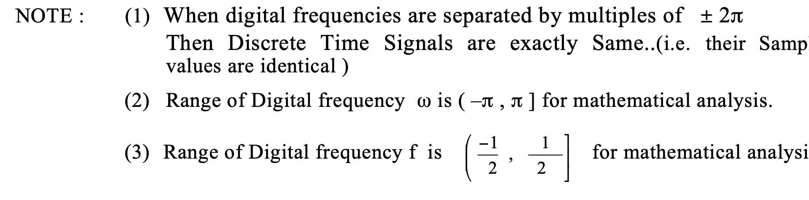

Slide 27
(1) What is DSP ?
Ans :
Digital Signal Processing is a technique that converts signals from real world sources (usually in analog form) into digital data that can then be analyzed.

Slide 28
(2) What do you mean by real time signal ?
Ans :
Signal is processed with the same speed it is captured.
Signal is not stored before processing.
Entire input signal is never available before processing.

Slide 29
For example, in digital telephone system, Signal is captured, Sampled, Processed , Transmitted and Made it available to the end user.
Real Time Processing is Online Processing

Slide 30
(3) What is Analog Signal, Digital Signal, CT signal, DT Signal ?
Analog Signal : Signal value can be anything. NO fixed signal level.
Eg x(t) =cos(100π t). ⬅ Continuous
Sinusoidal signal
x[n] = { 10.5, 4.7, 3.5, 5.7, 3.8 }
⬅ Sampled signal

Slide 31
Digital Signal :
Only two levels +5v and 0 V.
ie. Logically High and Low.
Eg. Binary data
0 | 1 | 0 | 1 | 1 | 0 | 1 | 0

Slide 32
Continuous Time Signal : Signal is defined for every value of time. Signal value can be anything.
Eg. x(t) =cos(100π t). ⬅ Continuous
Sinusoidal
Signal

Slide 33
Discrete Time Signal :
Signal is defined for Discrete instant of Time.
NOT for every value of time. Signal value can be anything.
Eg. x[n] = { 10.5, 4.7, 3.5, 5.7, 3.8 }
⬅ sampled signal

Slide 34
CONCEPT of Signal Processing
  Signals commonly need to be processed in a variety of ways. For example, the output signal from a transducer may well be contaminated with unwanted electrical "noise".

Slide 35
The electrodes attached to a patient's chest when an ECG is taken measure tiny electrical voltage changes due to the activity of the heart and other muscles.

Slide 36

Analog and Digital signals
In many cases, the signal is initially in the form of an analog electrical voltage or current, produced for example by a microphone or some other type of transducer.

Slide 37
In some situations the data is already in digital form - such as the output from the readout system of a CD (compact disc) player.

Slide 38
An analog signal must be converted into digital (i.e. numerical) form before DSP techniques can be applied.
There are two main kinds of filter, analog and digital. They are quite different in their physical makeup and in how they work.

Slide 39
An analog filter uses analog electronic circuits made up from components such as resistors, capacitors and op amps to produce the required filtering effect. Such filter circuits are widely used in such applications as noise reduction, video signal enhancement, graphic equalizers in hi-fi systems, and many other areas.

Slide 40
There are well-established standard techniques for designing an analog filter circuit for a given requirement. At all stages, the signal being filtered is an electrical voltage or current which is the direct analogue of the physical quantity (e.g. a sound or video signal or transducer output) involved

Slide 41
  Analog and digital filters
In signal processing, the function of a filter is to remove unwanted parts of the signal, such as random noise, or to extract useful parts of the signal, such as the components lying within a certain frequency range.

Slide 42
The following block diagram illustrates the basic idea.
A digital filter uses a digital processor to perform numerical calculations on sampled values of the signal. The processor may be a general-purpose computer such as a PC, or a specialized DSP (Digital Signal Processor) chip.

Slide 43
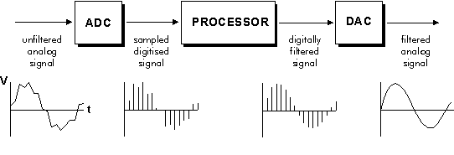
Note that in a digital filter, the signal is represented by a sequence of numbers, rather than a voltage or current.
The following diagram shows the basic setup of such a system.

Slide 44
Fast DSP processors can handle complex combinations of filters in parallel or cascade (series), making the hardware requirements relatively simple and compact in comparison with the equivalent analog-circuitry

Slide 45

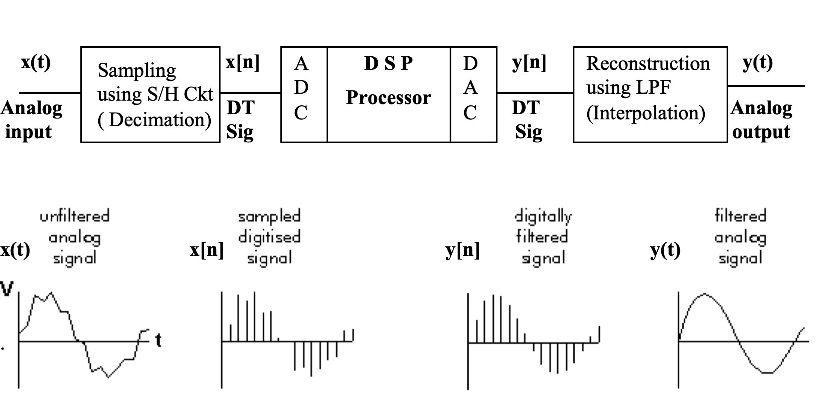
What is DSP SYSTEM?

Slide 46
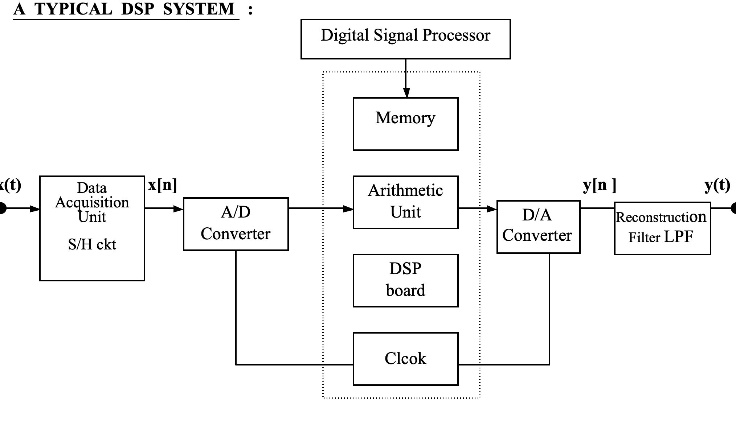
A Typical DSP System….

Slide 47
Sampling
x(t)
Sampling
ALGO :
Put t = nTs
x[n]
DT Signal
OUTPUT
CT Signal
INPUT

Slide 48
Reconstruction
x[n]
Reconstruction
ALGO :
Put n = t Fs
x(t)
CT Signal
OUTPUT
DT Signal
INPUT

Slide 49
H.W. Let x[t] = 10 cos(100πt) + 20 cos( 120πt)-5 sin(50πt).
If x(t) is sampled with sampling frequency Fs = 200 Hz. What will be Discrete Time Signal x[n] at n=0 ?

Slide 50




Dr. Kiran TALELE
Stay Connected….
Mobile : 091-9987030881
eMail : talelesir@gmail.com
kiran.talele@spit.ac.in
Facebook : www.facebook.com/ Kiran-Talele-1711929555720263
Linkedln : https://www.linkedin.com/in/k-t-v-talele/

Slide 51
Dr. Kiran TALELE is an Associate Professor in Electronics & Telecommunication Engineering Department of Bharatiya Vidya Bhavans’ Sardar Patel Institute of Technology, Mumbai with 33+ years experience in Academics.
He is a Dean of Students, Alumni and External Relations at Sardar Patel Institute of Technology, Andheri Mumbai.
He is also a Head of Sardar Patel Technology Business Incubator, Mumbai.
His area of research is Digital Signal & Image Processing, Computer Vision, Machine Learning and Multimedia System Design.
He has published 85+ research papers at various national & international refereed conferences and journals. He has filed published 25+ patents at Indian Patent Office. One patent is granted in 2021.
He is a Treasurer of IEEE Bombay Section and Mentor for Startup Incubation & Intellectual Asset Creation.
He is a recipient of P.R. Bapat IEEE Bombay Section Outstanding Volunteer Award 2019.

